Slide 1

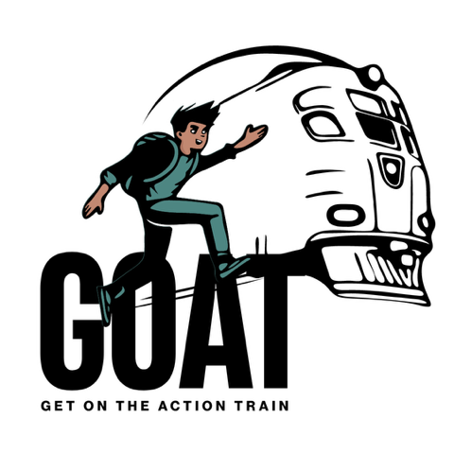
Preobrazbena znanja za trajnostni razvoj
April 7th 2025
Virtualna učilnica G.O.A.T. Projekt
Prepared & Lead by Irina Stefanova-Parigvozdeva, ACC, IDGs Ambassador Bulgaria

Slide 2

Namen okvira IDG je pomagati ljudem razumeti, kako je lahko videti notranji razvoj in zakaj je pomemben za kataliziranje zunanjih sprememb.
Notranji ni enak individualnemu
‘„narava notranjega razvoja je po svoji osnovi kolektivna, sistemska, večdimenzionalna, nelinearna, kompleksna, in neurejena.’

Slide 3
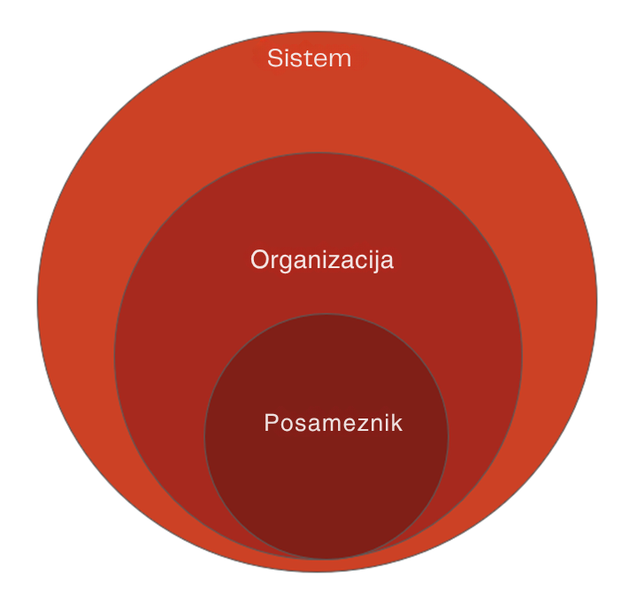
Čestitke, ker ste prevzeli poslanstvo opolnomočenja mladih, podpore mladim in kultivacije skupnosti s svojimi močnimi pobudami - ki so na pragu uresničitve! Trajnostni razvoj izhaja iz notranjega razvoja; Je bistvenega pomena za doseganje trajnih zunanjih sprememb.
Upoštevajte te 3 ravni

Slide 4
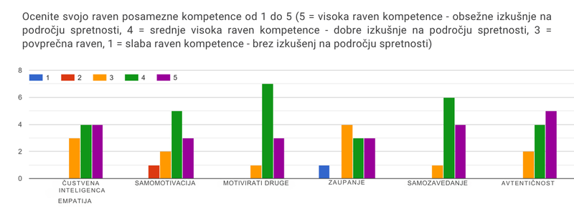
INTROSPEKCIJA (ČUSTVENI DEJAVNIKI).
Vir: GOAT Mapa kompetenc

Slide 5
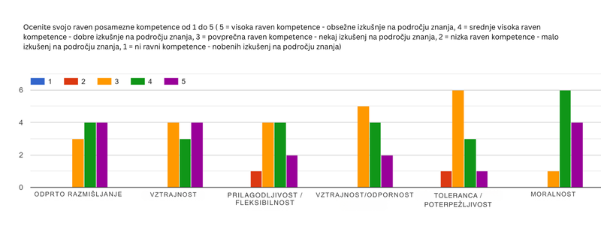
POGLED NA SVET/KAKO SE VEDEM
Vir: GOAT Mapa kompetenc

Slide 6
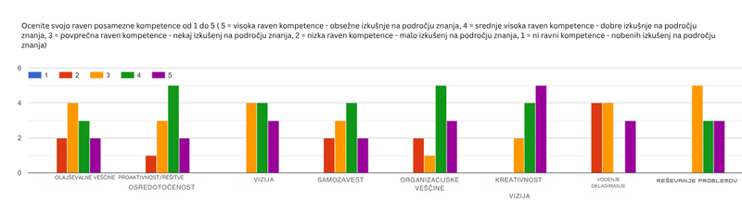
VODSTVENA ZNANJA
Vir: GOAT Mapa kompetenc

Slide 7
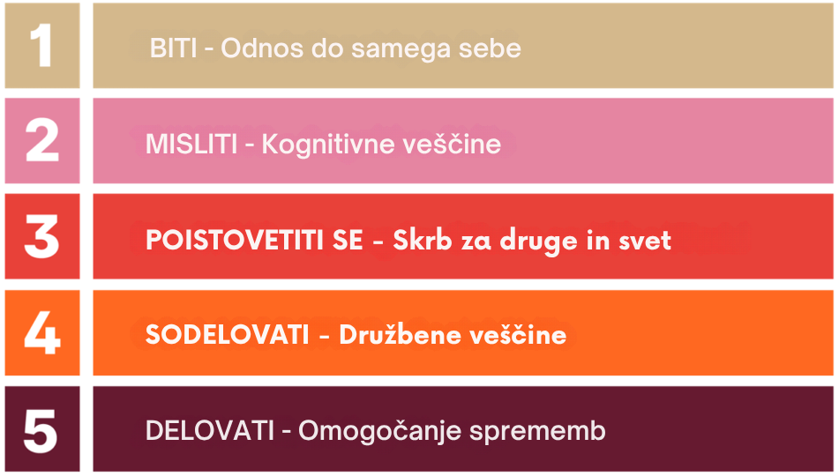

Slide 8
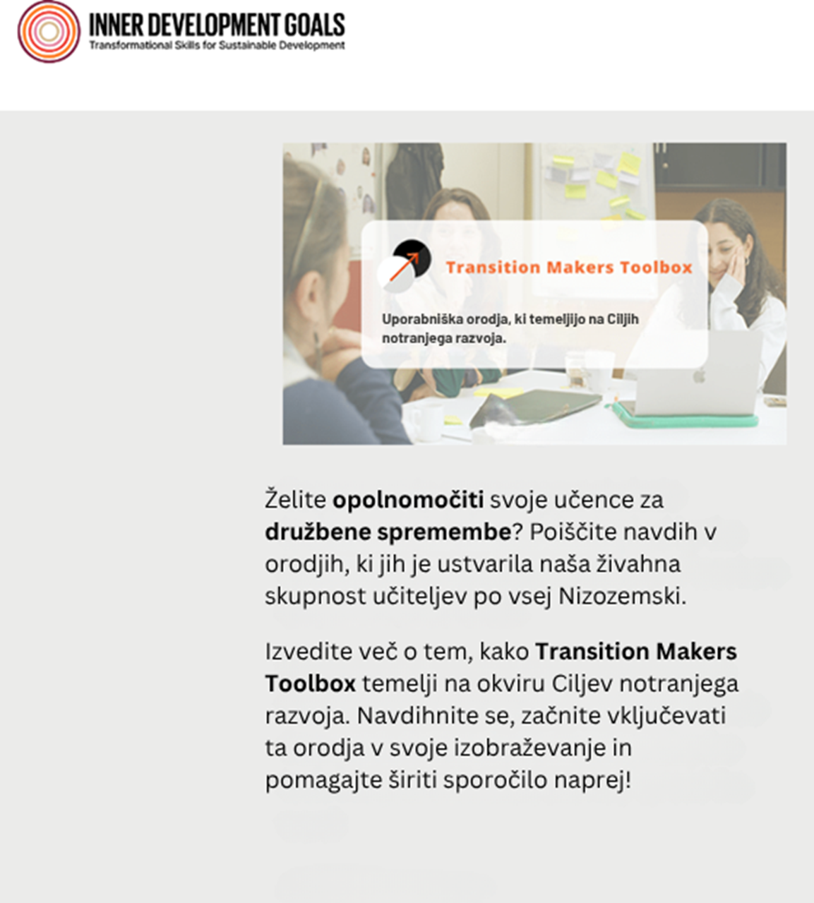
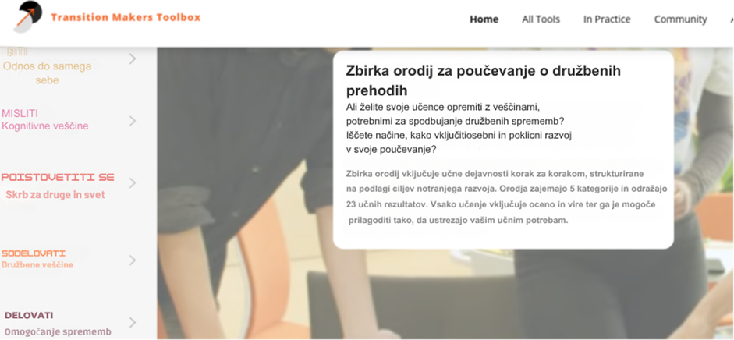
Raziščite orodja in tehnike za izvajanje:IDG 5 področij razvoja (23 veščin)
https://innerdevelopmentgoals.org/about/resources/
https://transitionmakers.nl/

Slide 9
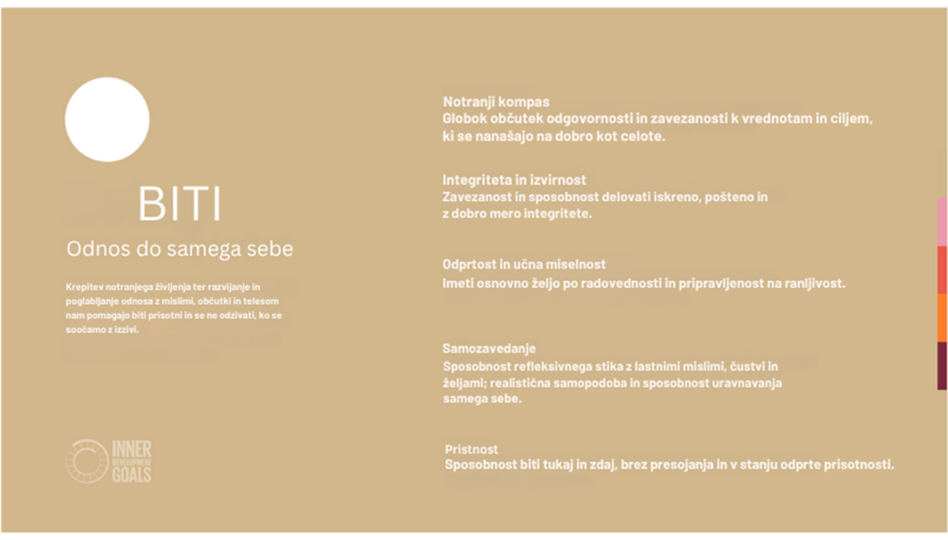

Slide 10
BITI
„Prisotnost je stanje bivanja, ki nam je vedno dostopno. Stanje prisotnosti (postanemo popolnoma prisotni) dosežemo tako, da: se dotaknemo svojega notranjega zavedanja (onkraj ega) ter postanemo popolnoma zavestni sedanjega trenutka.“
- Ekhart Tolle
To je stanje preseganja EGO. Opustiti gonjo za egoistično vizijo samega sebe.Opustiti gonjo za egoistično vizijo samega sebe
V stanju PRISOTNOSTI imamo še vedno strah, tesnobo, razočaranje, depresijo in druga „slaba“ čustva, vendar nas ne motijo. Stvari ne označujemo kot dobre ali slabe in tako ne ustvarjamo negativnosti ali nepotrebnega stresa. Ego je tisti, ki označuje in ustvarja stres; naša notranja zavest tega ne počne.
„Ni dobrega ali slabega, ampak je to posledica razmišljanja.“ - William Shakespeare
PRISOTEN

Slide 11

Osredotočanje. Vodena meditacija

Slide 12
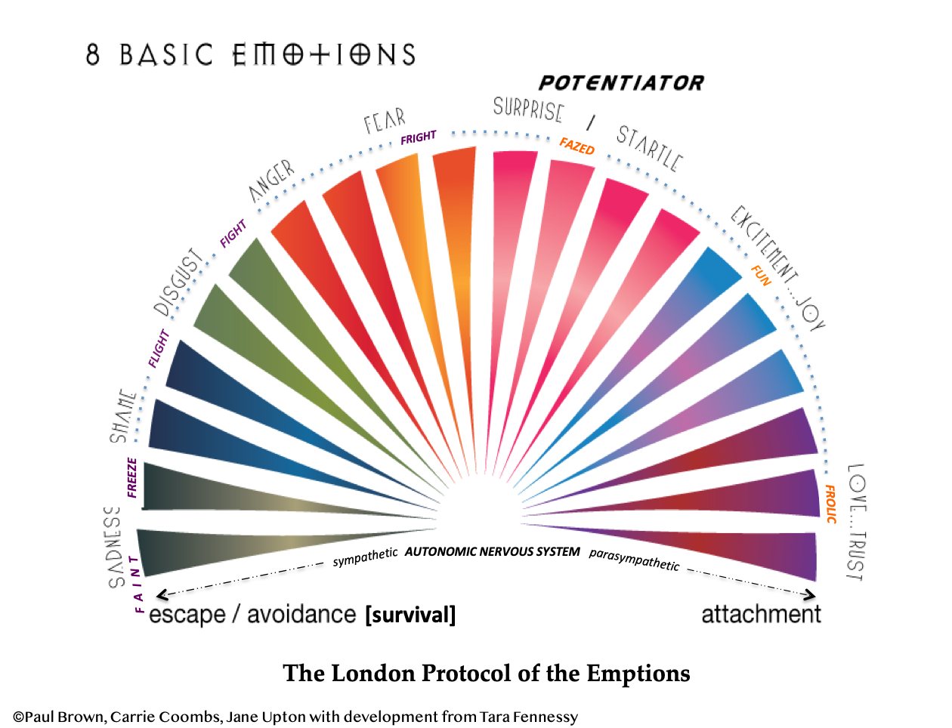
BITI
Biti prisoten je veščina, ki jo je treba vaditi. Kadarkoli se vam začne motati um, vrnite svojo pozornost nazaj v sedanjost.
PRISOTEN
Kako mi to čustvo služi?
Kje v telesu jo čutim?
Katere spremembe opazim v svojem vedenju po tem, ko se ukvarjam z njim?
*Obdelava čustev je veščina opazovanja, poimenovanja in upočasnitve čustev, da lahko sprejemate dobre odločitve in se mirneje premikate naprej.

Slide 13
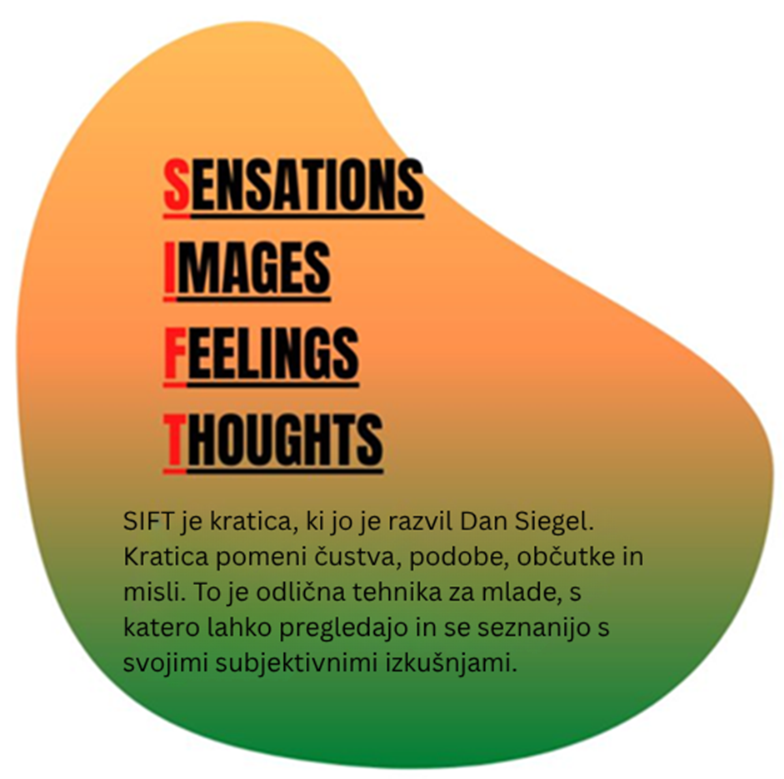
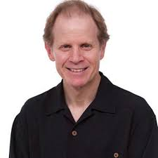
How to Manage My Emotions?
Self-Regulation: techniques
Občutki - opazovanje in opisovanje dogajanja v telesu - fizični občutki v telesu
Podobe - kakšne podobe se vam trenutno porajajo v mislih; nekaj vizualnega.
Opazujte svoja čustva - opazite in poimenujte čustvo, ki se dogaja v vas - opišite ga, kolikor lahko - žalostno, jezno, prestrašeno, veselo...
Misli - kakšne so vaše misli?
vam pomaga izboljšati zavedanje o tem, kaj čutite, upočasniti dogajanje in ugotoviti, kaj se vam dogaja.
SIFT skill by Dan Siegel
Notes:
Breathing – square breathing, longer exhale (the insula lerns that it might be safe out there) – prolong the breathing-out phase
An aroused state makes the amygdala more alert to danger
Not surprisingly the amygdala finds more triggers and we perceive the world as a much more dangerous and negative place.
When amygdala is calm, our PFC is active, giving it a chance to see the world more objectively
1.IDENTIFY YOUR TRIGGERS. Write a list of events that leave you emotionally drained, with one or two ways to reduce your distress for each. When they occur, use them as an opportunity to practise your stress management techniques. Keep notes on what works for next time.
2.PRACTICE THE RULE OF 3. Gaze into the distance and name three things you see. Then, stop and name three sounds you hear. Finally, take a moment to notice and wiggle three body parts.
3.REWARD YOURSELF REGULARLY. It’s important to find joy in the small things and to wallow in moments of pleasure. Schedule indulgences that you can look forward to. The feel-good neurotransmitter dopamine is released not only when we receive a reward the first time but in anticipation of a reward or completion of a goal.
3.WALK IN NATURE. Gentle repetitive exercises such as walking, swimming, and cycling are good for relieving stress and can be thought of as meditation in motion. When you exercise, you’re taking action. You’re getting out of your mind into your body. And by moving your body, you’re reminding your brain that you retain agency. Your brain evolved to move your body through the world, so moving your body reminds your brain you’re not helpless — you can still act independently and make choices.
4.BREATHE A PHYSIOLOGICAL SIGH. Slow, deep-breathing exercises evoke the relaxation response by complex biomechanical and neural mechanisms that activate the parasympathetic nervous system. But another technique I’ve recently learned about is the physiological sigh: Breath in twice in quick succession through your nose (you’ll make a sniffing sound as you do so). Hold your breath for four seconds. Then, slowly exhale through your mouth (if you purse your lips like you’re blowing through a straw, that helps slow your breath down even more).
5.RELAX, MUSCLE BY MUSCLE. In progressive muscle relaxation, you tense up particular muscles and then relax them. Starting with the muscles in your legs and gradually work your way up your body. Tense each muscle group in turn. Make sure you can feel the tension, but not so much that you feel much pain. Keep the muscle tensed for about five seconds. Relax the muscles and keep them relaxed for approximately 10 seconds. It may be helpful to say something like “Relax” as you relax the muscles.
6.TRY TO STICK TO YOUR TIME ZONE. Often, we feel worried because we’re in a future-focussed state of mind. So, try to think about what is happening right now versus what might happen in the future.

Slide 14

Kako kontrolirati svoja čustva?
Samoregulacija: tehnike
Kaj še lahko deluje, če zavestna meditacija ne deluje?
Prepoznajte svoje sprožilce
Vadite pravilo 3
Poglejte v daljavo in navedite tri stvari, ki jih vidite. Nato se ustavite in poimenujte tri zvoke, ki jih slišite. Na koncu si vzemite trenutek, da opazite tri dele telesa in jih premaknite.
Hodite v naravi
Nagradite samega sebe
Vdihnite Fiziološki vzdih
(dva vdiha, ki jima sledi podaljšani izdih)
Sproščajte, mišico za mišico
Poskusite se držati svojega časovnega pasu
Notes:
Breathing – square breathing, longer exhale (the insula lerns that it might be safe out there) – prolong the breathing-out phase
An aroused state makes the amygdala more alert to danger
Not surprisingly the amygdala finds more triggers and we perceive the world as a much more dangerous and negative place.
When amygdala is calm, our PFC is active, giving it a chance to see the world more objectively
1.IDENTIFY YOUR TRIGGERS. Write a list of events that leave you emotionally drained, with one or two ways to reduce your distress for each. When they occur, use them as an opportunity to practise your stress management techniques. Keep notes on what works for next time.
2.PRACTICE THE RULE OF 3. Gaze into the distance and name three things you see. Then, stop and name three sounds you hear. Finally, take a moment to notice and wiggle three body parts.
3.REWARD YOURSELF REGULARLY. It’s important to find joy in the small things and to wallow in moments of pleasure. Schedule indulgences that you can look forward to. The feel-good neurotransmitter dopamine is released not only when we receive a reward the first time but in anticipation of a reward or completion of a goal.
3.WALK IN NATURE. Gentle repetitive exercises such as walking, swimming, and cycling are good for relieving stress and can be thought of as meditation in motion. When you exercise, you’re taking action. You’re getting out of your mind into your body. And by moving your body, you’re reminding your brain that you retain agency. Your brain evolved to move your body through the world, so moving your body reminds your brain you’re not helpless — you can still act independently and make choices.
4.BREATHE A PHYSIOLOGICAL SIGH. Slow, deep-breathing exercises evoke the relaxation response by complex biomechanical and neural mechanisms that activate the parasympathetic nervous system. But another technique I’ve recently learned about is the physiological sigh: Breath in twice in quick succession through your nose (you’ll make a sniffing sound as you do so). Hold your breath for four seconds. Then, slowly exhale through your mouth (if you purse your lips like you’re blowing through a straw, that helps slow your breath down even more).
5.RELAX, MUSCLE BY MUSCLE. In progressive muscle relaxation, you tense up particular muscles and then relax them. Starting with the muscles in your legs and gradually work your way up your body. Tense each muscle group in turn. Make sure you can feel the tension, but not so much that you feel much pain. Keep the muscle tensed for about five seconds. Relax the muscles and keep them relaxed for approximately 10 seconds. It may be helpful to say something like “Relax” as you relax the muscles.
6.TRY TO STICK TO YOUR TIME ZONE. Often, we feel worried because we’re in a future-focussed state of mind. So, try to think about what is happening right now versus what might happen in the future.

Slide 15
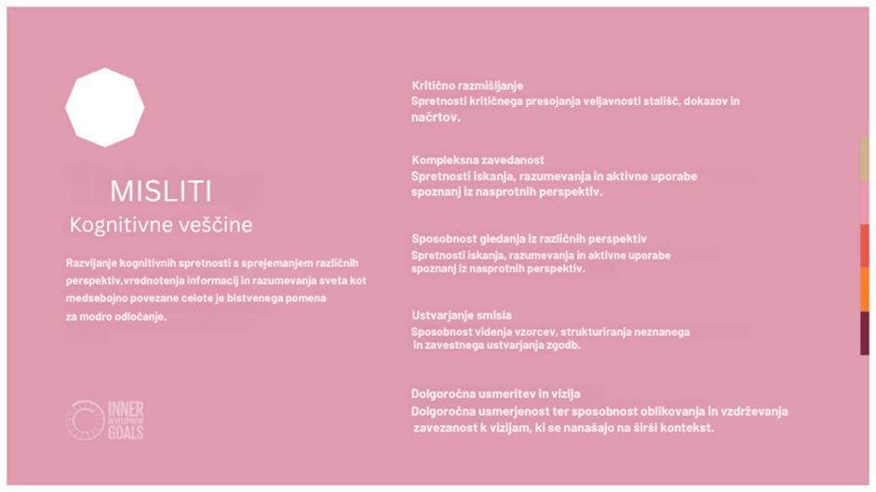

Slide 16
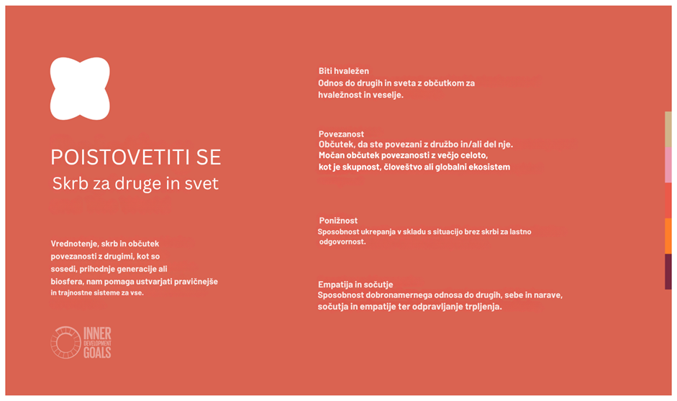

Slide 17
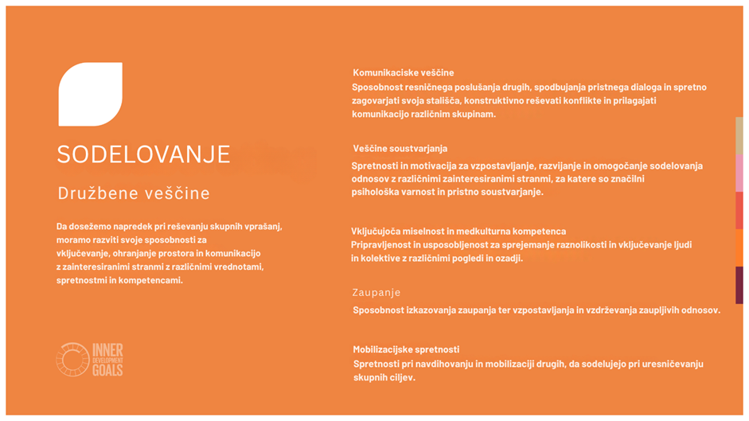

Slide 18
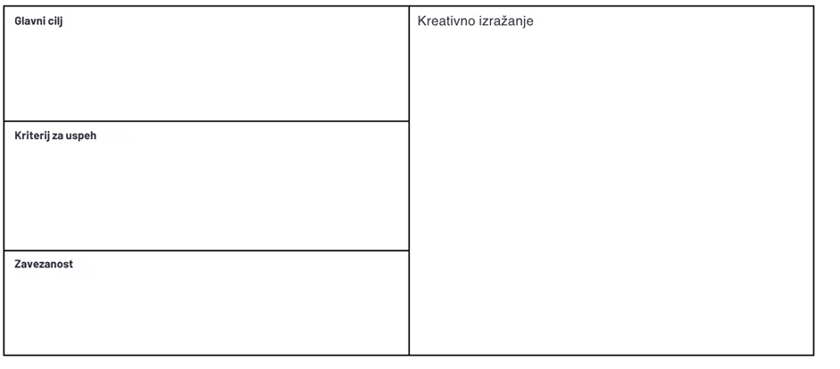
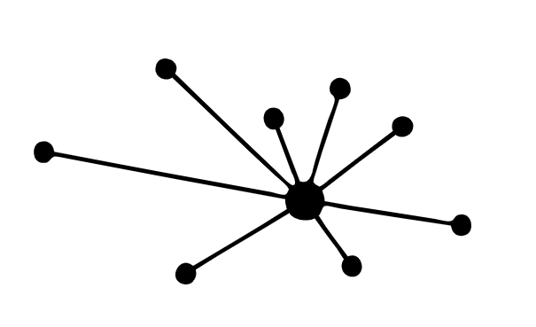
Načrt sodelovanja Ekipe prevedejo svoja zbrana pričakovanja * deluje kot povzetek in simbol sodelovanja v ekipi
Določanje ciljev: kakšen je glavni cilj tega sodelovanja?
Na koncu ekipa oblikuje ustvarjalni izraz, ki simbolizira sodelovanje njihove ekipe.
Ta izraz ima lahko kakršno koli obliko, na primer simbol, sliko, stavek ali živi kip.
Kakšna so naša merila za uspeh?
Kdaj smo zadovoljni z vnosom?
In kdaj smo zadovoljni z rezultati?
Zakaj je naš cilj pomemben?
Kako se zavzemamo za ta cilj?
Vir slike:
http://logobook.com/business/business-development/

Slide 19
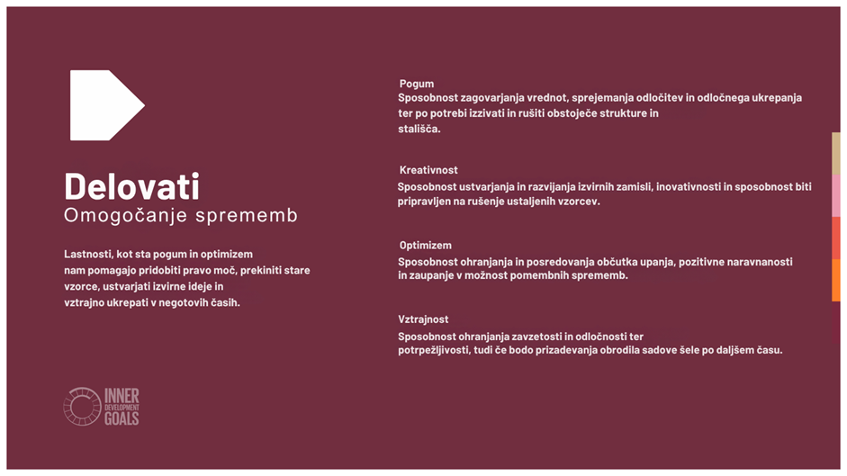

Slide 20

Prepared & Lead by Irina Stefanova-Parigvozdeva, ACC, IDGs Ambassador Bulgaria

