Slide 1









GETTING STARTED WITH CANVA: A BEGINNER’S GUIDE
AGREEMENT NUMBER: 2023-1-DE04-KA220-YOU-000123686 PROGRAMME: ERASMUS+, KEY ACTION 2, COOPERATION PARTNERSHIP

Slide 2

GETTING STARTED WITH CANVA: A BEGINNER’S GUIDE
WHAT IS CANVA?
  FREE ONLINE GRAPHIC DESIGN TOOL
  USED TO CREATE SOCIAL MEDIA POSTS, POSTERS, PRESENTATIONS, RESUMES, AND MORE
  DRAG-AND-DROP INTERFACE WITH THOUSANDS OF TEMPLATES
  PERFECT FOR BEGINNERS AND PROFESSIONALS ALIKE
AGREEMENT NUMBER: 2023-1-DE04-KA220-YOU-000123686 PROGRAMME: ERASMUS+, KEY ACTION 2, COOPERATION PARTNERSHIP

Slide 3
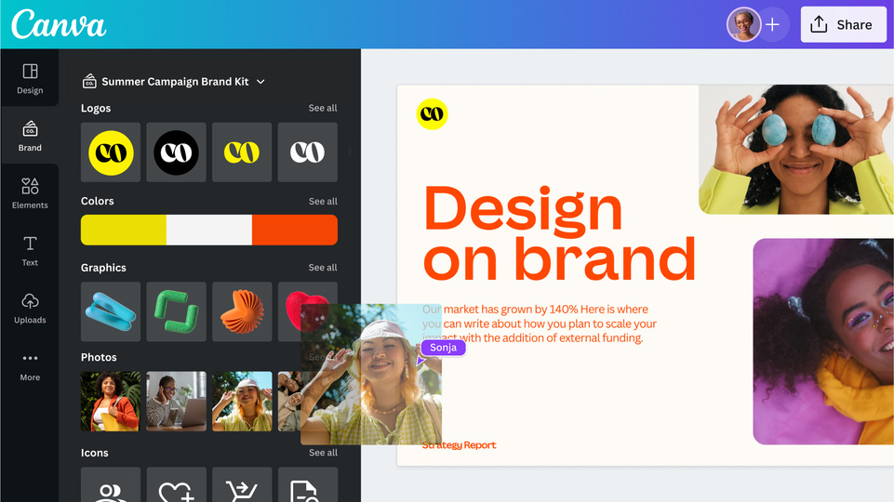
GETTING STARTED WITH CANVA: A BEGINNER’S GUIDE
WHY USE CANVA?
  SUPER EASY TO USE (NO DESIGN SKILLS NEEDED!)
  ACCESS TO THOUSANDS OF TEMPLATES AND FREE ELEMENTS
  CLOUD-BASED (WORKS ON ANY DEVICE)
  GREAT FOR COLLABORATION (INVITE OTHERS TO EDIT)
AGREEMENT NUMBER: 2023-1-DE04-KA220-YOU-000123686 PROGRAMME: ERASMUS+, KEY ACTION 2, COOPERATION PARTNERSHIP

Slide 4
GETTING STARTED WITH CANVA: A BEGINNER’S GUIDE
GETTING STARTED:
  STEP 1: GO TO WWW.CANVA.COM
  STEP 2: CREATE A FREE ACCOUNT (EMAIL, GOOGLE, OR FACEBOOK)
  STEP 3: CHOOSE WHAT YOU WANT TO DESIGN (E.G., INSTAGRAM POST, POSTER, PRESENTATION)
AGREEMENT NUMBER: 2023-1-DE04-KA220-YOU-000123686 PROGRAMME: ERASMUS+, KEY ACTION 2, COOPERATION PARTNERSHIP

Slide 5
GETTING STARTED WITH CANVA: A BEGINNER’S GUIDE
CANVA DASHBOARD OVERVIEW
  EMPLATES (PRE-MADE DESIGNS)
  PROJECTS (YOUR SAVED DESIGNS)
  BRAND HUB (FOR COLORS, LOGOS – PREMIUM FEATURE)
  FOLDERS (ORGANIZE YOUR STUFF)
  CREATE A DESIGN (START FROM SCRATCH OR WITH A TEMPLATE)
AGREEMENT NUMBER: 2023-1-DE04-KA220-YOU-000123686 PROGRAMME: ERASMUS+, KEY ACTION 2, COOPERATION PARTNERSHIP

Slide 6
GETTING STARTED WITH CANVA: A BEGINNER’S GUIDE
BASIC TOOLS YOU NEED TO KNOW
  TEXT TOOL: ADD AND STYLE TEXT
  ELEMENTS: SHAPES, ICONS, LINES, CHARTS, ETC.
  UPLOADS: ADD YOUR OWN IMAGES OR VIDEOS
  PHOTOS/VIDEOS: FREE MEDIA LIBRARY
  BACKGROUNDS: COLORS, GRADIENTS, IMAGES
  TEMPLATES: START WITH A PRE-DESIGNED LAYOUT
AGREEMENT NUMBER: 2023-1-DE04-KA220-YOU-000123686 PROGRAMME: ERASMUS+, KEY ACTION 2, COOPERATION PARTNERSHIP

Slide 7
GETTING STARTED WITH CANVA: A BEGINNER’S GUIDE
LET’S CREATE A SIMPLE DESIGN
  CHOOSE A SOCIAL MEDIA POST TEMPLATE
  CHANGE THE TEXT
  ADD A PHOTO
  ADJUST COLORS AND FONTS
  DOWNLOAD OR SHARE
AGREEMENT NUMBER: 2023-1-DE04-KA220-YOU-000123686 PROGRAMME: ERASMUS+, KEY ACTION 2, COOPERATION PARTNERSHIP

Slide 8
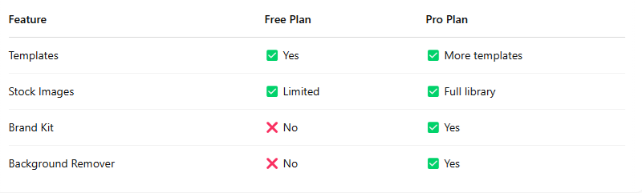
GETTING STARTED WITH CANVA: A BEGINNER’S GUIDE
FREE VS PRO
AGREEMENT NUMBER: 2023-1-DE04-KA220-YOU-000123686 PROGRAMME: ERASMUS+, KEY ACTION 2, COOPERATION PARTNERSHIP

Slide 9
GETTING STARTED WITH CANVA: A BEGINNER’S GUIDE
FINAL TIPS & RESOURCES
  EXPLORE CANVA’S DESIGN SCHOOL FOR TUTORIALS
  TRY CREATING SOMETHING SMALL DAILY
  EXPERIMENT AND HAVE FUN WITH YOUR CREATIVITY!
AGREEMENT NUMBER: 2023-1-DE04-KA220-YOU-000123686 PROGRAMME: ERASMUS+, KEY ACTION 2, COOPERATION PARTNERSHIP

