Slide 1









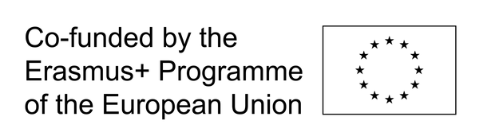
BUILDING LEADERSHIP, COMMUNICATION AND PROBLEM-SOLVING SKILLS
GOAT Bootcamp session - 7. 5. 2025
FACILITATED BY: ANA MLADENOVIĆ, CELJE YOUTH CENTRE
AGREEMENT NUMBER: 2023-1-DE04-KA220-YOU-000123686 PROGRAMME: ERASMUS+, KEY ACTION 2, COOPERATION PARTNERSHIP

Slide 2

BUILDING LEADERSHIP, COMMUNICATION AND PROBLEM-SOLVING SKILLS
OBJECTIVES
  TO OFFER MENTORING SUPPORT TO YOUNG PEOPLE WORKING ON THEIR PROJECTS;
  TO FOCUS ON SKILL-BUILDING IN THREE KEY AREAS:
    LEADERSHIP,
    COMMUNICATION AND
    PROBLEM-SOLVING.
  TO PROVIDE MENTORING GUIDANCE;
  TO ANSWER QUESTIONS AND ADDRESS ANY DILEMMAS.
AGREEMENT NUMBER: 2023-1-DE04-KA220-YOU-000123686 PROGRAMME: ERASMUS+, KEY ACTION 2, COOPERATION PARTNERSHIP
Notes:
So, let's dive right in with the objectives for today:
• the main goal of this session is to offer you mentoring support and
• TO focus on building some key skills for successful youth initiatives:
o leadership,
o communication and
o problem-solving skills.

Slide 3

BUILDING LEADERSHIP, COMMUNICATION AND PROBLEM-SOLVING SKILLS
LEADERSHIP SKILLS
WHAT MAKES A GOOD LEADER?
AGREEMENT NUMBER: 2023-1-DE04-KA220-YOU-000123686 PROGRAMME: ERASMUS+, KEY ACTION 2, COOPERATION PARTNERSHIP
Notes:
Let's begin with leadership skills. To kick things off, I want to hear from you – what do you think makes a good leader?
Not everybody all at once please ☺
You can write into the chat if you don't want to speak up
A: Yes, yes, all essential qualities
/
B: ok, maybe a bit of introduction will help first.

Slide 4

BUILDING LEADERSHIP, COMMUNICATION AND PROBLEM-SOLVING SKILLS
LEADERSHIP SKILLS
AGREEMENT NUMBER: 2023-1-DE04-KA220-YOU-000123686 PROGRAMME: ERASMUS+, KEY ACTION 2, COOPERATION PARTNERSHIP
Notes:
A: Let's compare some of what you mentioned with this short clip on what youth thinks are the qualities that make somebody a great leader /
B: let's take a look at a short video on what youth thinks are the qualities that make somebody a great leader.

Slide 5
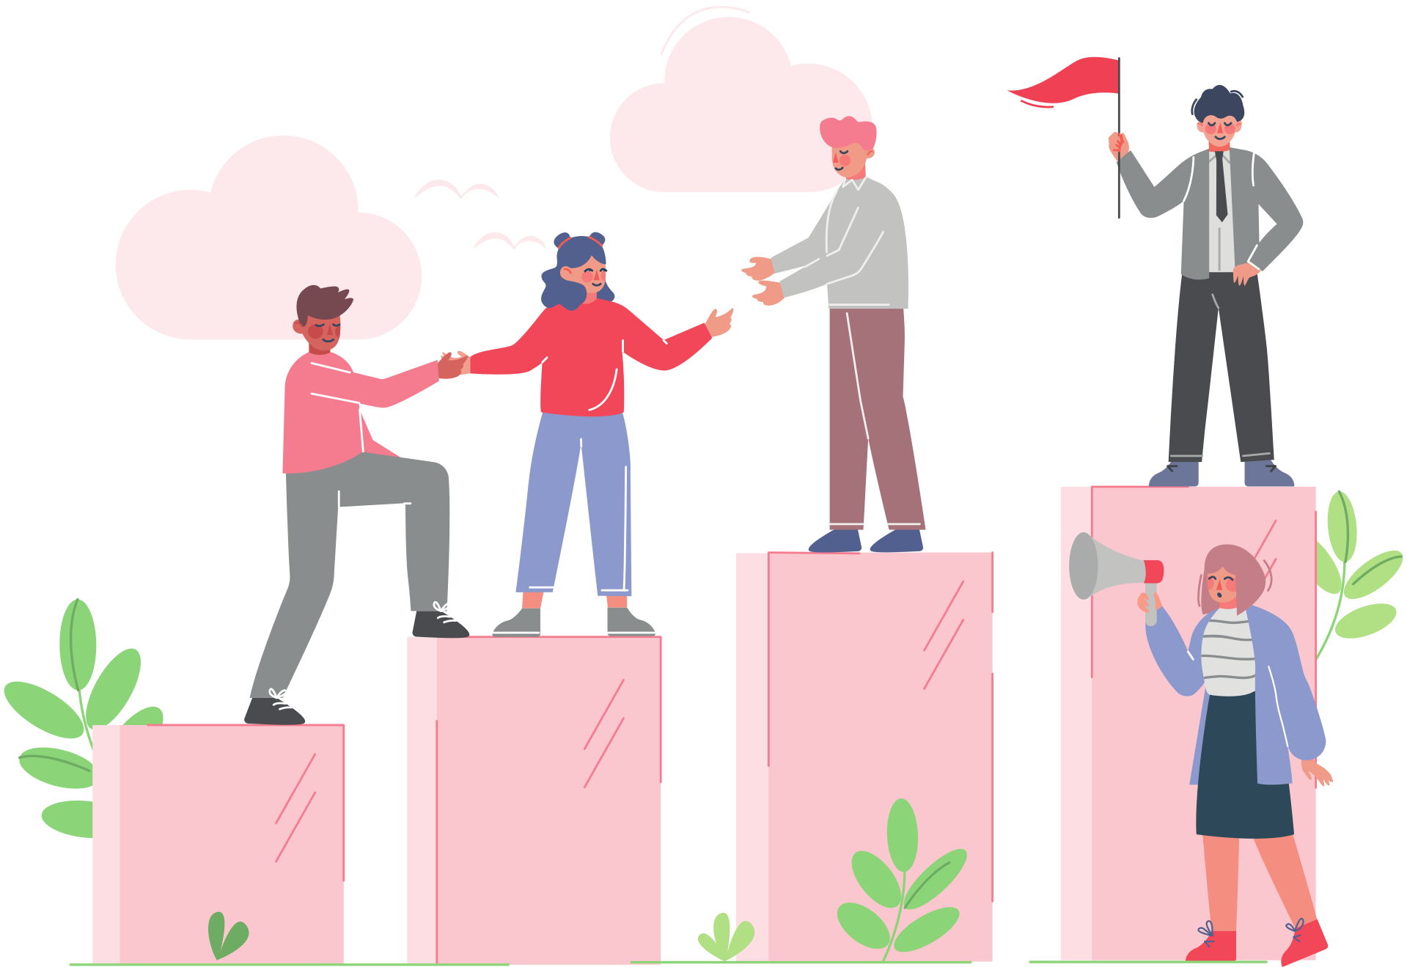
BUILDING LEADERSHIP, COMMUNICATION AND PROBLEM-SOLVING SKILLS
LEADERSHIP SKILLS
WHAT MAKES A GOOD LEADER?
  TAKING INITIATIVE
  INSPIRING OTHERS THROUGH VISION AND VALUES (PASSIONATE ABOUT THEIR CAUSE)
  BEING ACCOUNTABLE AND RELIABLE (HAVING INTEGRITY)
  BEING HONEST
  LEADING BY EXAMPLE
  PRACTICING ACTIVE LISTENING
AGREEMENT NUMBER: 2023-1-DE04-KA220-YOU-000123686 PROGRAMME: ERASMUS+, KEY ACTION 2, COOPERATION PARTNERSHIP
Notes:
So, now that we seen the video, do you agree? Do you think they left something important out?
- A true leader is definitely somebody that takes initiative.
- It's also important that he knows how to inspire others through vision and values (meaning that they are Passionate about their cause)
- Also, being accountable and reliable is an essential quality of a leader. That means HAVING INTEGRITY and it also means being HONEST.
- We also heard in the video about leading by example – you cannot be a true leader if you don't practice what you preach. People quickly spot empty words and don't really want to follow somebody that doesn't inspire them through action.
- And the last one I included in the list is a very important one – leaders need to know how to practice active listening. That means not just listening but hearing what another person has to say. It entails being attentive, asking open-ended or probing questions, requesting clarification if needed, paraphrasing, summarizing and being attuned to feelings.

Slide 6
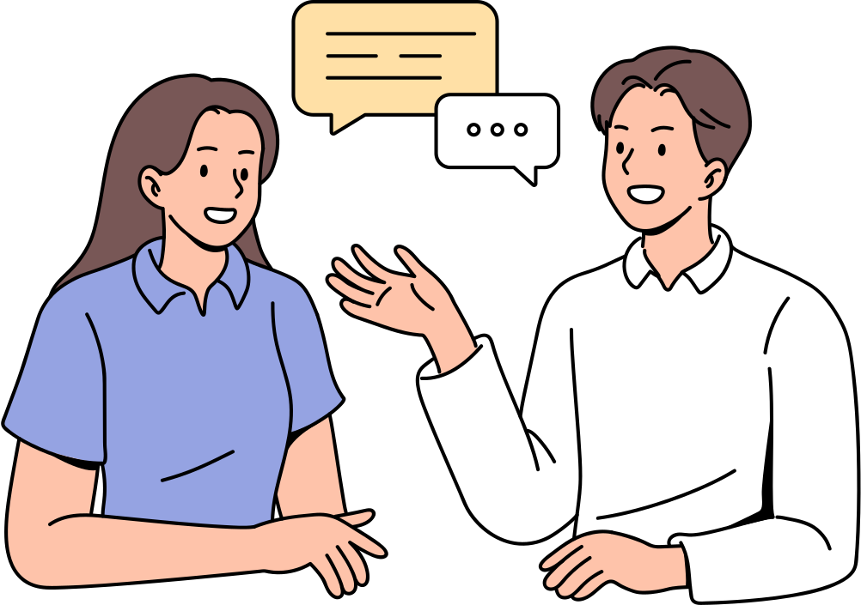
BUILDING LEADERSHIP, COMMUNICATION AND PROBLEM-SOLVING SKILLS
COMMUNICATION SKILLS
SPEAK TO BE HEARD, LISTEN TO UNDERSTAND
CLEAR & CONFIDENT VERBAL COMMUNICATION
BODY LANGUAGE + TONE OF VOICE
ACTIVE LISTENING
NAVIGATING DIFFICULT CONVERSATIONS
KNOW YOUR AUDIENCE (ADJUSTING THE MESSAGE)
TIME TO THINK: WHAT’S THE BEST WAY TO GET YOUR MESSAGE ACROSS?
  COMMUNICATION TOOLS
  TARGET AUDIENCE
AGREEMENT NUMBER: 2023-1-DE04-KA220-YOU-000123686 PROGRAMME: ERASMUS+, KEY ACTION 2, COOPERATION PARTNERSHIP
Notes:
All this brings us to another very important set of skills – and this is COMMUNICATION SKILLS!
Communication is important, especially in youth initiatives, when working in groups. Having effective communication tools and skills can empower you to confidently take on different tasks and engage in a local community in a genuine and relatable way.
- It's imporant that your verbal communication is clear & confident
- but not only verbal, a huge part of communication skills is also nonverbal communication skills. you have to be aware of your body language & tone of voice, because your body can say a lot even when completely silent.
- active listening, we already mentioned, but it is essential also for navigating difficult conversations with style and skill.
- and maybe the most important thing to remember is - know your audience. if you know who you're speaking to, you can adjust the message and make sure it is received as intended.
NOW, IF YOU THINK ABOUT YOUR YOUTH INITIATIVE, THE PROJECTS YOU'RE WORKING ON… HOW DO YOU THINK IS THE BEST WAY TO GET YOUR MESSAGE ACROSS?
THINK ABOUT - WHAT COMMUNICATION TOOLS CAN YOU USE? WHO'S YOUR AUDIENCE?
Young voices resonate with their peers – SO leverage social media, creative events, and the power of storytelling to mobilize and connect.

Slide 7

BUILDING LEADERSHIP, COMMUNICATION AND PROBLEM-SOLVING SKILLS
COMMUNICATION SKILLS
SPEAK TO BE HEARD, LISTEN TO UNDERSTAND
ACTIVITY: DESCRIBE THIS COMMON OBJECT IN ONE SENTENCE IN A CLEAR AND CONCISE WAY.
BANNED WORDS: BRUSH, TEETH, MOUTH, CLEAN, PASTE
AGREEMENT NUMBER: 2023-1-DE04-KA220-YOU-000123686 PROGRAMME: ERASMUS+, KEY ACTION 2, COOPERATION PARTNERSHIP
Notes:
Now, let's shake things up a bit with a quick activity. You can see here a picture of a common, everyday object. We all know what it is. Your job is to describe it as clear and concise as possible.
Try to be short and to the point. Imagine you're talking to somebody and want them to know what you're talking about, but you cannot say the name of the object – also, there are a few banned words which you are not allowed to use.
I'll give you a minute and when you come up with a good description, you can either tell us your description or you can write it in the chatbox. I'm looking forward to your creative solutions.
A: Great examples /
B: yea, if you think about it, it's quite challenging to come up with a good and concise description of something if we can't rely on specific words.
But this is what good communicators are skilled in – bringing the message across – short, clear and to the point.
You can practice with other examples and build your vocabulary and communication skills!

Slide 8



BUILDING LEADERSHIP, COMMUNICATION AND PROBLEM-SOLVING SKILLS
PROBLEM-SOLVING SKILLS
THINK IT, BREAK IT, SOLVE IT
  DEFINING THE REAL PROBLEM
  BRAINSTORMING WITH AN OPEN MIND
  BREAKING DOWN BIG ISSUES INTO SMALL STEPS
  CREATIVE THINKING AND RESOURCEFULNESS
  COLLABORATION TO FIND SOLUTIONS
PROBLEM IDEAS ACTION
AGREEMENT NUMBER: 2023-1-DE04-KA220-YOU-000123686 PROGRAMME: ERASMUS+, KEY ACTION 2, COOPERATION PARTNERSHIP
Notes:
So, on to solving some problems!
- For successful problem solving you need to first understand what the problem is – and define it as clearly as possible.
- Then, brainstorming is always a good option – keep an open mind and collect as many ideas as you can.
- Next step is to break down big issues into small steps. This way big problems become more manegable and less terrifying. Let's take a look at a short videoclip where Michele Wucker discusses this point.
VIDEO
- So, here the topic was climate crisis, but we can apply the same principle to your youth initiatives. So, your goal is to successfully execute your idea - ask yourself, what is the first step in this process? And then, what comes next? and so on ... you get the idea.
- But To really make a step towards the end solution, you have to think creatively and be resourceful in the process. Try thinking out of the box. If something doesn't work, don't stop there. Take it as a challenge to find a new solution that works better.
- And the last thing – don't be afraid to ask for help. You work in a team. Collaborate with other members to find solutions. Ask your mentors. More people means more ideas and a greater chance to find a solution for the problem.

Slide 9
BUILDING LEADERSHIP, COMMUNICATION AND PROBLEM-SOLVING SKILLS
PROBLEM-SOLVING SKILLS
THINK IT, BREAK IT, SOLVE IT
PROBLEM IDEAS ACTION
AGREEMENT NUMBER: 2023-1-DE04-KA220-YOU-000123686 PROGRAMME: ERASMUS+, KEY ACTION 2, COOPERATION PARTNERSHIP
Notes:
Let's take a look at one more video, this one is about 5 minutes long, but it really explains one of the best techniques and approaches to the problem-solving process - and it does so very clearly.

Slide 10



BUILDING LEADERSHIP, COMMUNICATION AND PROBLEM-SOLVING SKILLS
PROBLEM-SOLVING SKILLS
THINK IT, BREAK IT, SOLVE IT
SCENARIO
A GROUP OF YOUNG PEOPLE IS WORKING ON A YOUTH MENTAL HEALTH AWARENESS CAMPAIGN IN THEIR LOCAL COMMUNITY. THEY'VE PLANNED A SERIES OF EVENTS AND SOCIAL MEDIA POSTS TO ENGAGE PEERS AND RAISE AWARENESS.
PROBLEM
AFTER LAUNCHING THE CAMPAIGN, THE TEAM NOTICES THAT ENGAGEMENT IS LOW, ESPECIALLY FROM THE TARGET GROUP THEY WANTED TO REACH — TEENS FROM RURAL AREAS AND VOCATIONAL SCHOOLS. MEMBERS FEEL DISHEARTENED AND UNCERTAIN WHETHER THE PROJECT IS MAKING ANY REAL IMPACT.
CHALLENGE
HOW WOULD YOU, AS PART OF THIS INITIATIVE, USE LEADERSHIP, COMMUNICATION, AND PROBLEM-SOLVING SKILLS TO ADDRESS THIS SITUATION?
AGREEMENT NUMBER: 2023-1-DE04-KA220-YOU-000123686 PROGRAMME: ERASMUS+, KEY ACTION 2, COOPERATION PARTNERSHIP
Notes:
Now, let's try this in practice. Here we have a scenario – and a problem. Your challenge is to find a solution for this problem, by using your leadership, communication and problem-solving skills.
So, imagine you're in a group, that is WORKING ON A YOUTH MENTAL HEALTH AWARENESS CAMPAIGN IN YOUR LOCAL COMMUNITY. YOU'VE PLANNED A SERIES OF EVENTS AND SOCIAL MEDIA POSTS TO ENGAGE PEERS AND RAISE AWARENESS.
BUT ….
After launching the campaign, your team notices that engagement is low, especially from the target group you wanted to reach — teens from rural areas and vocational schools. Your team feels disheartened and uncertain whether the project is making any real impact.
How would you go about solving this problem? I'll give you a few minutes to think about it, to consider different strategies and then maybe somebody can share their solution.
- - -
Ok, so I think we all had enough time to think about the possible solutions. Don't be shy, either type it in the chat or you can speak up.
A: If nobody wants to share, maybe we can move forward, hopefully you all thought of something so revolutionary that you decided you want to keep it to yourself ☺
/
B: Yes, these are great solutions! Thank you for contributing.

Slide 11
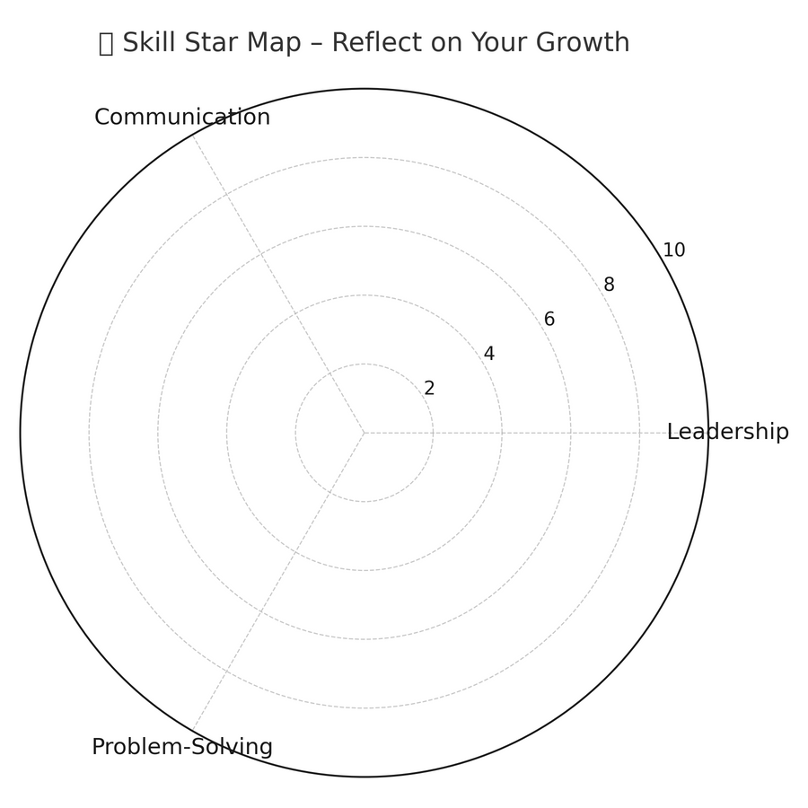


BUILDING LEADERSHIP, COMMUNICATION AND PROBLEM-SOLVING SKILLS
Q&A and MENTORING SUPPORT
LET’S TALK!
Q & A - YOUTH INITIATIVES / OUR PROJECTS
0 (center) = no skills
10 (outer edge) = master
AGREEMENT NUMBER: 2023-1-DE04-KA220-YOU-000123686 PROGRAMME: ERASMUS+, KEY ACTION 2, COOPERATION PARTNERSHIP
Notes:
Now, let's talk. If you have any questions about your initiative, where to start, how to tackle this one big problem you're facing … You're not alone. Partners of GOAT project are here, to offer you mentoring support and guide you along the way. So if anybody has any questions, dillemas, please, ask away.
…
You can write it in the chat if you want to…
Remember, You can also always turn to mentors from your country if there's anything you're not sure about …
…
Ok, [since we don't have any questions], here is one handy activity for self-reflection – it's a Skill star map – to reflect on your growth in 3 key areas we talked about today:
• 🌟 Leadership
• 🗣 Communication
• 🧠 Problem-Solving
Your task is to dot your current position on each axis from the center (low confidence/experience) to the edge (high confidence/experience), forming a shape that reflects your current strengths and areas for growth.
I'm giving you a minute to do that, you can use a paper and pencil or just visualise, whatever works for you.
And don't worry, I won't go around asking everybody what their shape was, the purpose of this activity is to really take a moment to self reflect, think about your position, ask yourself:
o How confident do I feel in this area?
o How often do I practice this skill in real life?
Then when you're ready, place a dot along the axis between 0 (center) and 10 (outer edge) and Connect the dots to form your “Skill Star”.
Now that we all did that - let's Reflect on the shape: Ask yourselves:
o Is it balanced?
o Where would I like to grow?
o What’s one small action I can take next?
🧠 Reflection Prompts:
• What surprised you about your shape?
• Which skill has grown the most in the past 6 months?
• What’s one real-life moment when you used one of these skills recently?
• Which area would you love to explore more deeply?
Ok, I want to thank you all for joining today, before we finish, I would just like to remind everyone to fill out the Competence map on the GOAT webpage. Some of you already did, others can maybe do it now, after the session, since everything we talked about today will really help you out to start thinking about your competences, where you are, and what you still need - to get to where you want to be at the end.
So, that's everything from my side, I want to thank you for today and wish you all the best with your projects!

